Slide 1
Video Game Asset Creation Pipeline
-
2D to 3D Conversion
Final Demo
Alex Banning

Slide 2
Review Our Goals
Understand Adobe Project Turntable and Project Neo well through the lens of game development and asset creation
Form a solid foundation for a thesis topic in robust 2D-to-3D reconstruction
Create a proof-of-concept application to demonstrate my understanding of these principles

Slide 3
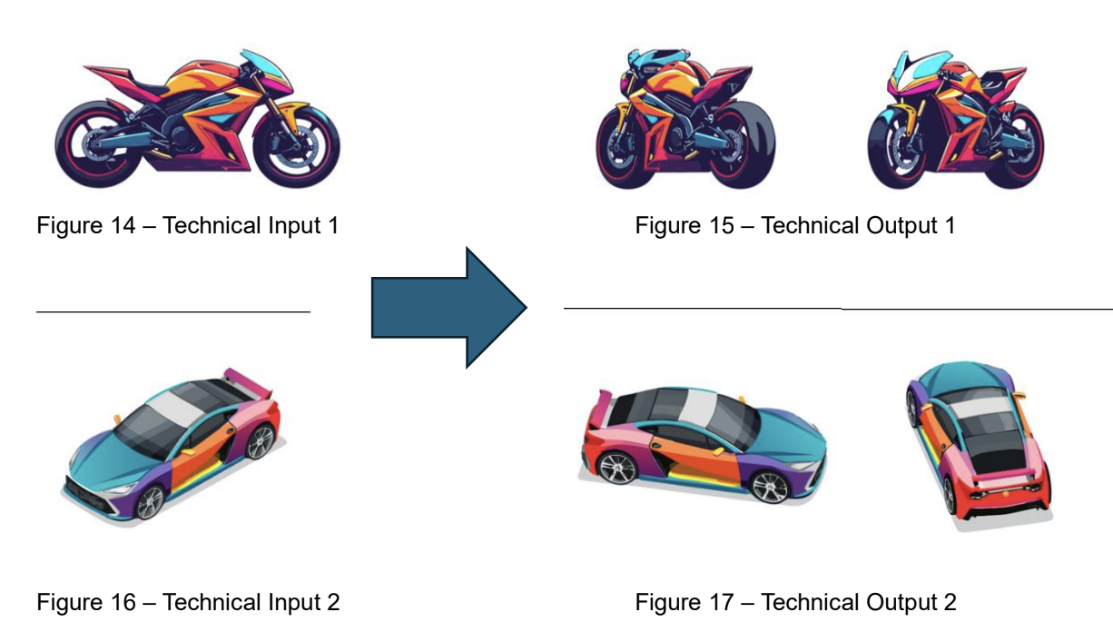
Adobe Turntable Review - Capabilities
Input: SVG File -> Output: SVG File (many views)
Backend: Uses AI (Adobe Firefly) to infer and generate angled views of input image
Is able to infer from any SVG input
All standard shapes/polygons
Path parsing
Grouping and layering for separation of nodes
Does extremely well with “cartoon-y” designs
Highly-detailed line work and groupings but not worried about specific measurements

Slide 4
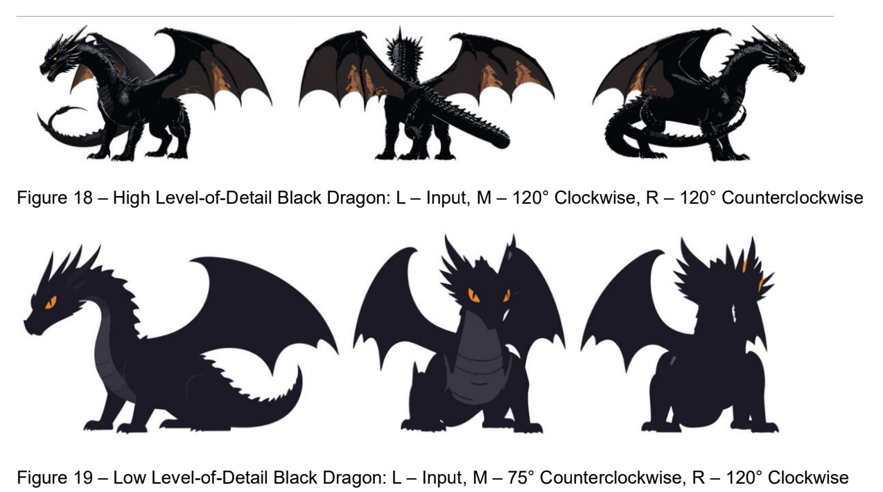
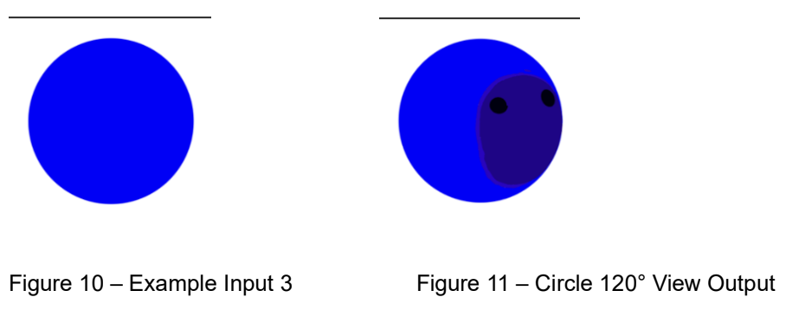
Adobe Turntable Review - Limitations
Hallucinates with simple geometric shapes
Less detail = more inference from AI
Messes up occlusion
If geometry is hidden by other shapes, inference becomes inaccurate
File output limited to SVG only (No use for 3D modeling without robust model to generate 3D mesh)

Slide 5
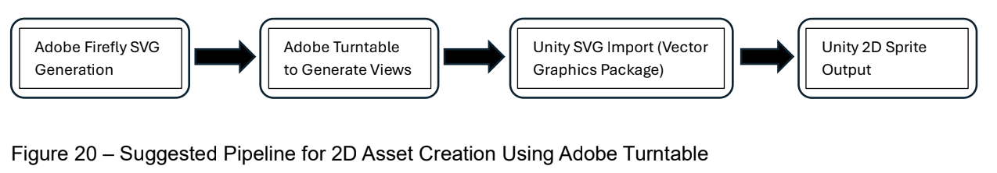
Adobe Turntable -
Uses in a Game Development Pipeline

Slide 6
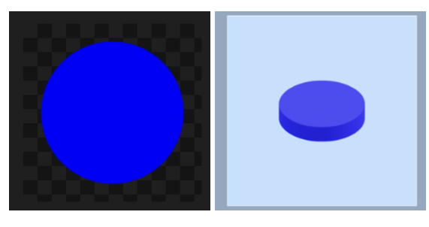
Adobe Project Neo Review - Capabilities
Input: SVG -> Output: .jpg, .png, .mp4, .svg
Generates 3D perspectives that can be edited volumetrically within Project Neo editor
Uses vertical extrusion, corner rounding, lighting effects, and other methods to create perception of 3D geometry
Very simple to import SVG files into editor

Slide 7
Adobe Project Neo Review - Limitations
Extremely limited I/O file types
Input: SVG only
Output: .png, .jpg, .mp4, .svg
Why “model” 3D behavior and not output 3D data types?
.fbx, .obj, .dwg
Really more oriented towards artists and graphic designers
Web-based editor is very laggy, especially with more complex geometries
Makes post editing shapes very frustrating
Only provides extrusion-based generation, not rotational or other

Slide 8
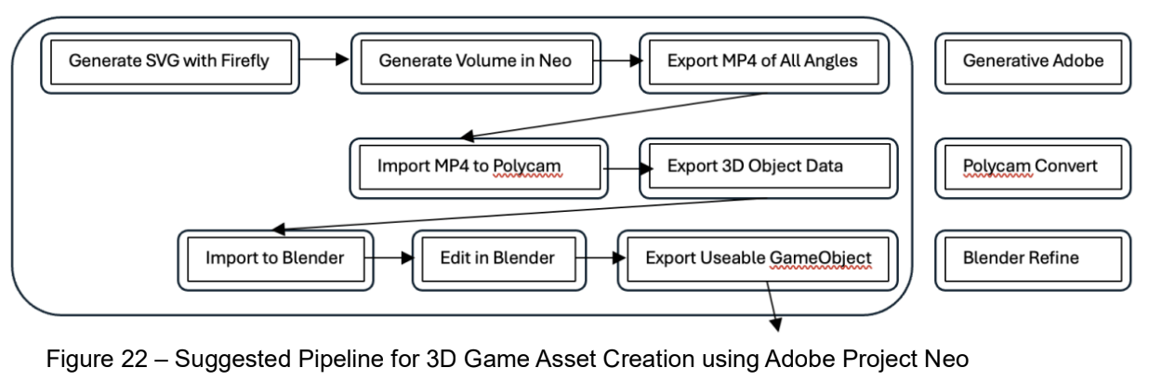
Adobe Project Neo -
Uses in a Game Development Pipeline

Slide 9
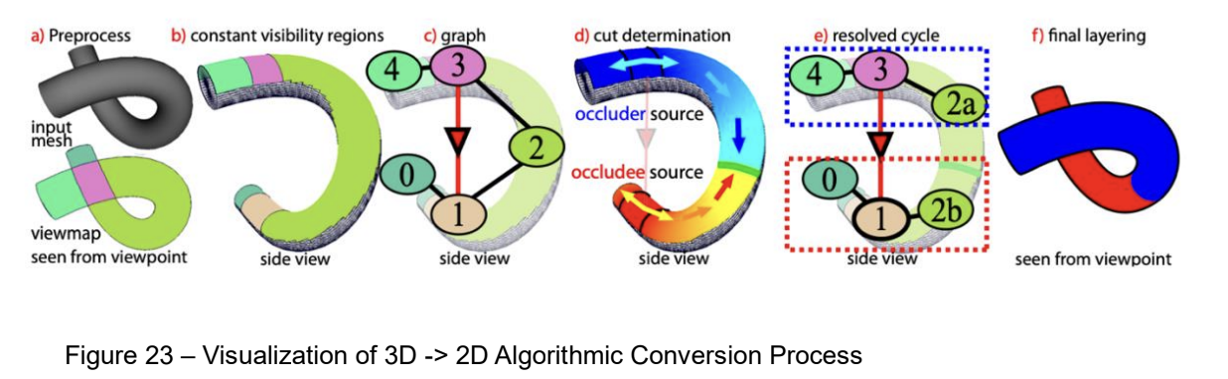
Other Research to Consider
3D mesh 2D vector graphics conversion
Describes how:
We can project the shape in 2D space
Find overlapping parts that lack clarity
Make cuts to separate connected faces
Define adjacent faces in a single layer and repeat
Key idea: reversing this process uncovers the lost data in 3D->2D

Slide 10
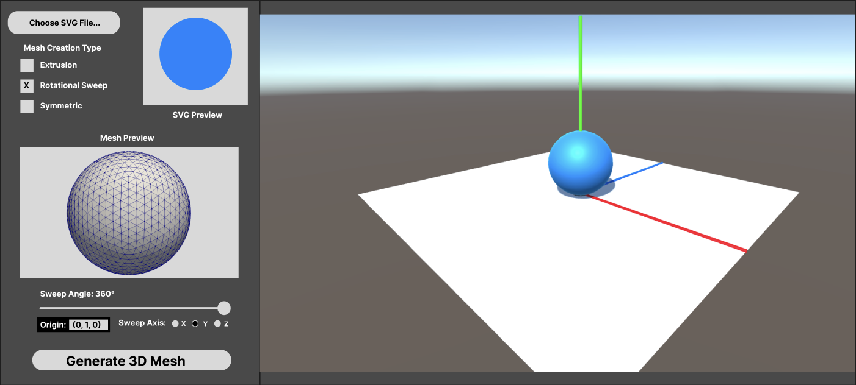
My Application - Proof-of-Concept
Take an SVG input
Parse it to define shape information determined by layers, groups, and elements
Allow user-defined parameters and assumptions to reintroduce lost information
Generate a usable 3D game object

Slide 11
Demo

Slide 12
Future Work to Be Implemented
Full support for robust SVG Parsing
Supporting differences in stroke and fill attributes
Support layers in complex reconstruction
Shadow and lighting support inferred from specified lighting layers
Completing mirror functionality
Including mesh editing in preview
Complex 2D-to-3D construction based on reversed algorithm discovered in research
Better UI and UX
Further testing: Use my game objects in a separate Unity project

Slide 13
Key Takeaways
Many people are working on tools to enable more efficient asset creation pipelines.
Highly desirable for game devs
Adobe’s Turntable and Neo present interesting ways AI-enhancement can be used to generate creative works, but they are not ready to be used in a production pipeline for game development.
Algorithmic generation of 3D objects from a 2D vector graphics file is possible, but extremely computationally difficult because of the loss of information between spaces.
With the rapid speed of AI development and investment, image-based generation of graphics is becoming increasingly common and more heavily researched.
Could lead to a more efficient approach for generation of 3D geometry if a model is trained on that specifically

Slide 14
References
[1] “Where is the time spent?,” The Game Development Stack Exchange, Jul. 15, 2010.
https://gamedev.stackexchange.com/questions/508/where-is-the-time-spent (accessed Dec. 06, 2025).
[2] “Do indie developers spend most of the time drawing assets for their games or programming
them?,” Quora, 2019. https://www.quora.com/Do-indie-developers-spend-most-of-the-time-drawing-
assets-for-their-games-or-programming-them (accessed Dec. 06, 2025).
[3] “Reddit - The heart of the internet,” Reddit.com, 2025.
https://www.reddit.com/r/gamedev/comments/4drkyh/what_percentage_of_game_development_teams_ar
e_in/ (accessed Dec. 06, 2025).
[4] “Reddit - The heart of the internet,” Reddit.com, 2022.
https://www.reddit.com/r/gamedev/comments/yvzfs2/question_for_indie_game_developers_whats_the/
(accessed Dec. 06, 2025).
[5] S. Bezzina and Alexiei Dingli, “My Teammate is an AI: Evaluating Generative AI in GameAsset
Creation through a Post-GameJam Study,” Jun. 2025, doi: https://doi.org/10.26503/dl.v2025i2.2438.
[6] A. Chia, “The artist and the automaton in digital game production,” Convergence: The International
Journal of Research into New Media Technologies, vol. 28, no. 2, p. 135485652210764, Feb. 2022, doi:
https://doi.org/10.1177/13548565221076434.
[7] “Making sure you’re not a bot!,” Erudit.org, 2025. https://www.erudit.org/en/journals/loading/2025-v17-
n27-loading010083/1118424ar.pdf
[8] “SVG Tutorial,” www.w3schools.com. https://www.w3schools.com/graphics/svg_intro.asp
[9] “View 2D objects from new angles,” Adobe.com, 2019. https://helpx.adobe.com/illustrator/desktop/use-
generative-ai/view-artwork-from-any-angle.html (accessed Dec. 01, 2025).
[10] “Project Turntable,” Adobe Research, 2020. https://research.adobe.com/video/project-turntable/
(accessed Dec. 01, 2025).
[11] Adobe, “#ProjectTurntable | Adobe MAX Sneaks 2024 | Adobe,” YouTube, Oct. 16, 2024.
https://www.youtube.com/watch?v=gfct0aH2COw
[12] “Reddit - The heart of the internet,” Reddit.com, 2024.
https://www.reddit.com/r/AdobeIllustrator/comments/1mtxoy9/turntable_feature_a_quick_overview/
(accessed Dec. 01, 2025).
[13] “‘About Vector Graphics | Vector Graphics | 2.0.0-preview.25,’” Unity 3D Docs, Sep. 24, 2018.
https://docs.unity3d.com/Packages/com.unity.vectorgraphics@2.0/manual/index.html (accessed Dec. 08,
2025).
[14] “View of The capabilities of the art-oriented artificial intelligence Adobe Firefly and its visual
advantages and disadvantages | Journal ‘Fundamental Sciences and Applications,’” Tu-plovdiv.bg, 2024.
https://journals.tu-plovdiv.bg/index.php/journal/article/view/868/54
[15] “Project Neo (Beta) overview,” Adobe.com, 2019. https://helpx.adobe.com/project-
neo/help/overview.html (accessed Dec. 01, 2025).
[16] Adobe Creative Cloud, “Instant Transformations with Project Neo (beta) | Adobe Creative
Cloud,” YouTube, Oct. 14, 2024. https://www.youtube.com/watch?v=p6GMIWfuaZA (accessed Dec. 07,
2025).
[17] “Polycam - LiDAR 3D Scanner,” poly.cam. https://poly.cam
[18] rileyb3d, “3D Game Assets From a Single Phone Scan in Blender,” YouTube, Jun. 29, 2023.
https://www.youtube.com/watch?v=JbKYvLTagn0 (accessed Nov. 12, 2025).
[19] E. Eisemann, S. Paris, and F. Durand, “A visibility algorithm for converting 3D meshes into editable
2D vector graphics,” ACM SIGGRAPH 2009 papers, pp. 1–8, Jul. 2009, doi:
https://doi.org/10.1145/1576246.1531389.

Slide 15
Thank You!
Questions?

